Slide 1
Digital Design & Computer Arch. Lecture 2b: Mysteries in Comp. Arch.
Prof. Onur Mutlu
ETH Zürich
Spring 2020
21 February 2020

Slide 2
How Do Problems Get Solved by Electrons?

Slide 3
Recall: The Transformation Hierarchy
Problem
Algorithm
Program/Language
System Software
Computer Architecture (expanded view)
SW/HW Interface
Computer Architecture (narrow view)
Micro-architecture
Logic
Devices
Electrons

Slide 4
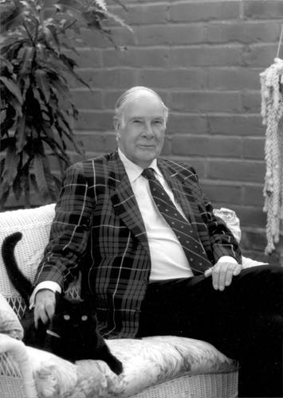
Levels of Transformation
“The purpose of computing is [to gain] insight” (Richard Hamming)
We gain and generate insight by solving problems
How do we ensure problems are solved by electrons?
Algorithm
Step-by-step procedure that is guaranteed to terminate where each step is precisely stated and can be carried out by a computer
Finiteness
Definiteness
Effective computability
Many algorithms for the same
problem
Problem
Algorithm
Program/Language
Runtime System
(VM, OS, MM)
ISA
(Instruction Set Architecture)
Interface/contract between SW and HW.
What the programmer assumes hardware will satisfy.
ISA (Architecture)
Microarchitecture
Logic
Devices
Electrons
Microarchitecture
An implementation of the ISA
Digital logic circuits
Building blocks of micro-arch (e.g., gates)
Notes:
ISA is the interface between hardware and software… It is a contract that the hardware promises to satisfy.
Algorithm: step by step procedure where each step is effectively computable (by a computer), is definite (precisely defined) – “do until fast” is not definite, and terminates
Hamming distance: number of locations in which the corresponding symbols of two equal-length strings is different
Hamming, Richard W. (1950), "Error detecting and error correcting codes", Bell System Technical Journal 29 (2): 147–160
Hamming codes

Slide 5
Aside: A Famous Work By Hamming
Hamming, “Error Detecting and Error Correcting Codes,” Bell System Technical Journal 1950.
Introduced the concept of Hamming distance
number of locations in which the corresponding symbols of two equal-length strings is different
Developed a theory of codes used for error detection and correction
Also see:
Hamming, “You and Your Research,” Talk at Bell Labs, 1986.
http://www.cs.virginia.edu/~robins/YouAndYourResearch.html

Slide 6
Levels of Transformation, Revisited
A user-centric view: computer designed for users
The entire stack should be optimized for user
Problem
Algorithm
Program/Language
User
Runtime System
(VM, OS, MM)
ISA
Microarchitecture
Logic
Devices
Electrons
Notes:
ISA is the interface between hardware and software… It is a contract that the hardware promises to satisfy.

Slide 7
The Power of Abstraction
Levels of transformation create abstractions
Abstraction: A higher level only needs to know about the interface to the lower level, not how the lower level is implemented
E.g., high-level language programmer does not really need to know what the ISA is and how a computer executes instructions
Abstraction improves productivity
No need to worry about decisions made in underlying levels
E.g., programming in Java vs. C vs. assembly vs. binary vs. by specifying control signals of each transistor every cycle
Then, why would you want to know what goes on underneath or above?

Slide 8
Crossing the Abstraction Layers
As long as everything goes well, not knowing what happens underneath (or above) is not a problem.
What if
The program you wrote is running slow?
The program you wrote does not run correctly?
The program you wrote consumes too much energy?
Your system just shut down and you have no idea why?
Someone just compromised your system and you have no idea how?
What if
The hardware you designed is too hard to program?
The hardware you designed is too slow because it does not provide the right primitives to the software?
What if
You want to design a much more efficient and higher performance system?

Slide 9
Crossing the Abstraction Layers
Two goals of this course (especially the second half) are
to understand how a processor works underneath the software layer and how decisions made in hardware affect the software/programmer
to enable you to be comfortable in making design and optimization decisions that cross the boundaries of different layers and system components

Slide 10
Some Example “Mysteries”

Slide 11
Four Mysteries: Familiar with Any?
Meltdown & Spectre (2017-2018)
Rowhammer (2012-2014)
Memories Forget: Refresh (2011-2012)
Memory Performance Attacks (2006-2007)

Slide 12
Mystery #1: Meltdown & Spectre

Slide 13
What Are These?
Source: J. Masters, Redhat, FOSDEM 2018 keynote talk.

Slide 14
Meltdown and Spectre Attacks
Someone can steal secret data from the system even though
your program and data are perfectly correct and
your hardware behaves according to the specification and
there are no software vulnerabilities/bugs

Slide 15
Meltdown and Spectre
Hardware security vulnerabilities that essentially effect almost all computer chips that were manufactured in the past two decades
They exploit “speculative execution”
A technique employed in modern processors for high performance
Speculative execution: Doing something before you know that it is needed
We do it all the time in life, to save time
Guess what will happen and act based on that guess
Processors do it, too, to run programs fast
They guess and execute code before they know it should be executed

Slide 16
Speculative Execution (I)
Modern processors “speculatively execute” code to improve performance:
if (account-balance <= 0) {
// do something
} else if (account-balance < 1M) {
// do something else
} else {
// do something else
}
Guess what code will be executed and execute it speculatively
- Improves performance, if it takes a long time to access account-balance
If the guess was wrong, flush the wrong instructions and execute the correct code

Slide 17
Speculative Execution is Invisible to the User
ISA
(Instruction Set Architecture)
Interface/contract between SW and HW.
What the programmer assumes hardware will satisfy.
Problem
Algorithm
Program/Language
System Software
SW/HW Interface
Microarchitecture
An implementation of the ISA
Micro-architecture
Logic
Programmer assumes their code
will be executed in sequential order
Devices
Electrons
Microarchitecture executes
instructions in a different order,
speculatively – but reports the results
as expected by the programmer

Slide 18
Meltdown and Spectre
Someone can steal secret data from the system even though
your program and data are perfectly correct and
your hardware behaves according to the specification and
there are no software vulnerabilities/bugs
Why?
Speculative execution leaves traces of secret data in the processor’s cache (internal storage)
It brings data that is not supposed to be brought/accessed if there was no speculative execution
A malicious program can inspect the contents of the cache to “infer” secret data that it is not supposed to access
A malicious program can actually force another program to speculatively execute code that leaves traces of secret data

Slide 19
Processor Cache as a Side Channel
Speculative execution leaves traces of data in processor cache
Architecturally correct behavior w.r.t. specification
However, this leads to a side channel: a channel through which someone sophisticated can extract information
Processor cache leaks information by storing speculatively-accessed data
A clever attacker can probe the cache and infer the secret data values
by measuring how long it takes to access the data
A clever attacker can force a program to speculatively execute code and leave traces of secret data in the cache

Slide 20
More on Meltdown/Spectre Side Channels
Source: https://googleprojectzero.blogspot.ch/2018/01/reading-privileged-memory-with-side.html

Slide 21
Three Questions
Can you figure out why someone stole your secret data if you do not know how the processor executes a program?
Can you fix the problem without knowing what is happening “underneath”, i.e., inside the microarchitecture?
Can you fix the problem well/fundamentally without knowing both software and hardware design?
Can you construct this attack or similar attacks without knowing what is happening underneath?

Slide 22
Three Other Questions
What are the causes of Meltdown and Spectre?
How can we prevent them (while keeping the performance benefits of speculative execution)?
Software changes?
Operating system changes?
Instruction set architecture changes?
Microarchitecture/hardware changes?
Changes at multiple layers, done cooperatively?
…
How do we design high-performance processors that do not leak information via side channels?

Slide 23
Meltdown/Spectre Span Across the Hierarchy
Problem
Algorithm
Program/Language
System Software
Computer Architecture (expanded view)
Meltdown/Spectre problem and solution space
SW/HW Interface
Computer Architecture (narrow view)
Micro-architecture
Logic
Devices
Electrons

Slide 24
Takeaway
Breaking the abstraction layers (between components and transformation hierarchy levels)
and knowing what is underneath
enables you to understand and solve problems

Slide 25
… and Also Understand/Critique Cartoons!
Source: https://xkcd.com/1938/

Slide 26
An Important Note: Design Goal and Mindset
Design goal of a system determines the design mindset and evaluation metrics
Meltdown and Spectre are there because the design goal of cutting-edge processors (employed everywhere in our lives)
has mainly been focused on high performance and low energy (relatively recently)
has not included security (or information leakage) as an important constraint
Incorporating security as a first-class constraint and “metric” into (hardware) design and education is critical in today’s world

Slide 27
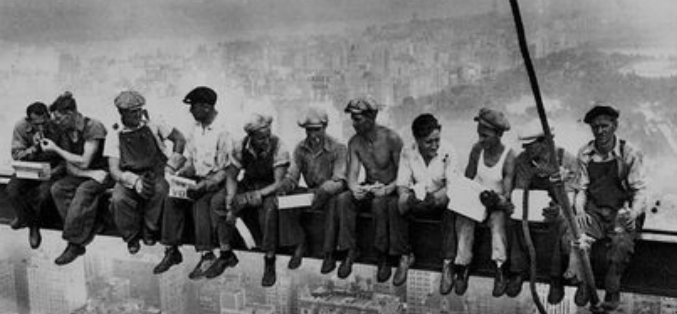
Design Mindset
Security is about preventing unforeseen consequences
Source: https://s-media-cache-ak0.pinimg.com/originals/48/09/54/4809543a9c7700246a0cf8acdae27abf.jpg

Slide 28
Two Other Goals of This Course
Enable you to think critically
Enable you to think broadly

Slide 29
To Learn and Discover Further
High-level Video by RedHat
https://www.youtube.com/watch?v=syAdX44pokE
A bit lower-level, comprehensive explanation by Y. Vigfusson
https://www.youtube.com/watch?v=mgAN4w7LH2o
Keep attending lectures and taking in all the material
Go and talk with myself in the future
I have many bachelor’s/master’s projects on hardware security
“Fundamentally secure computing architectures” is a key direction of scientific investigation and design

Slide 30
Mystery #2: RowHammer

Slide 31
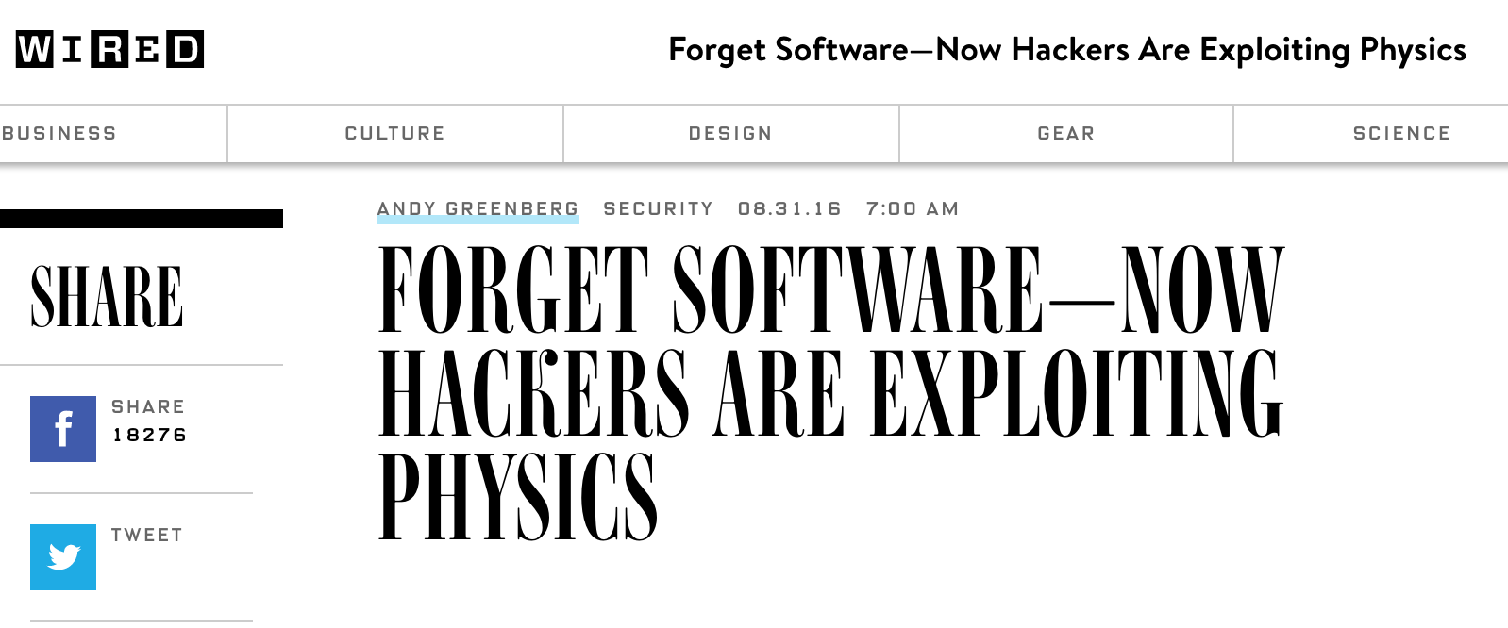
The Story of RowHammer
One can predictably induce bit flips in commodity DRAM chips
>80% of the tested DRAM chips are vulnerable
First example of how a simple hardware failure mechanism can create a widespread system security vulnerability

Slide 32
Modern DRAM is Prone to Disturbance Errors
Row of Cells
Wordline
Row
Victim Row
Row
Hammered Row
V_{LOW}
Opened
V_{HIGH}
Closed
Row
Victim Row
Row
Repeatedly opening and closing a row enough times within a refresh interval induces disturbance errors in adjacent rows in most real DRAM chips you can buy today
Flipping Bits in Memory Without Accessing Them: An Experimental Study of DRAM Disturbance Errors, (Kim et al., ISCA 2014)

Slide 33
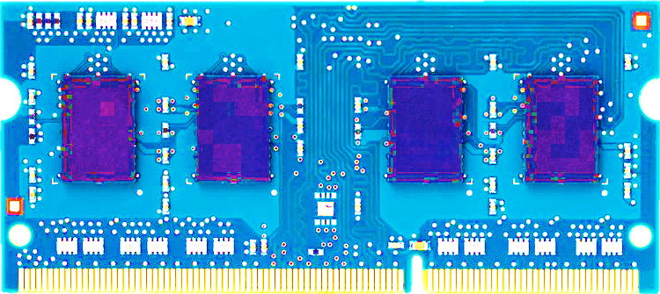
Most DRAM Modules Are Vulnerable
A company
B company
C company
86%
(37/43)
83%
(45/54)
88%
(28/32)
Up to
1.0×10⁷ errors
Up to
2.7×10⁶ errors
Up to
3.3×10⁵ errors
Flipping Bits in Memory Without Accessing Them: An Experimental Study of DRAM Disturbance Errors, (Kim et al., ISCA 2014)

Slide 34
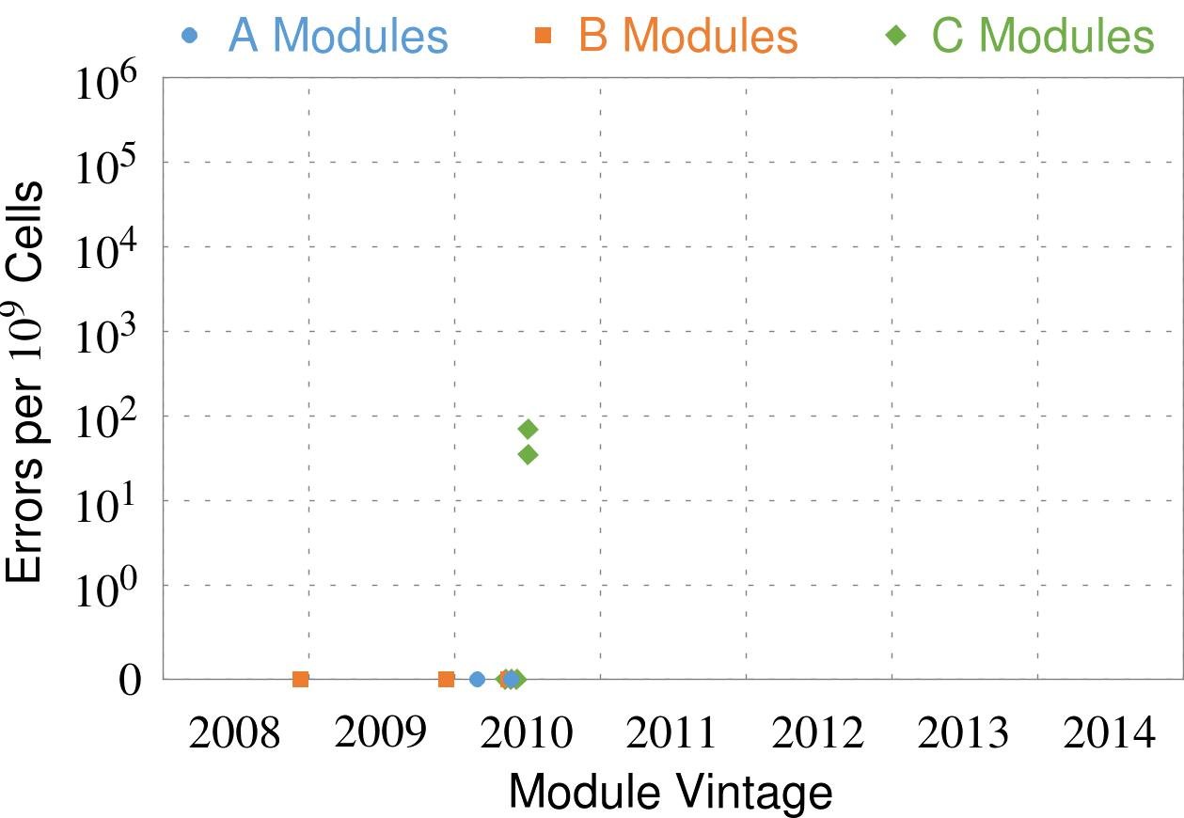
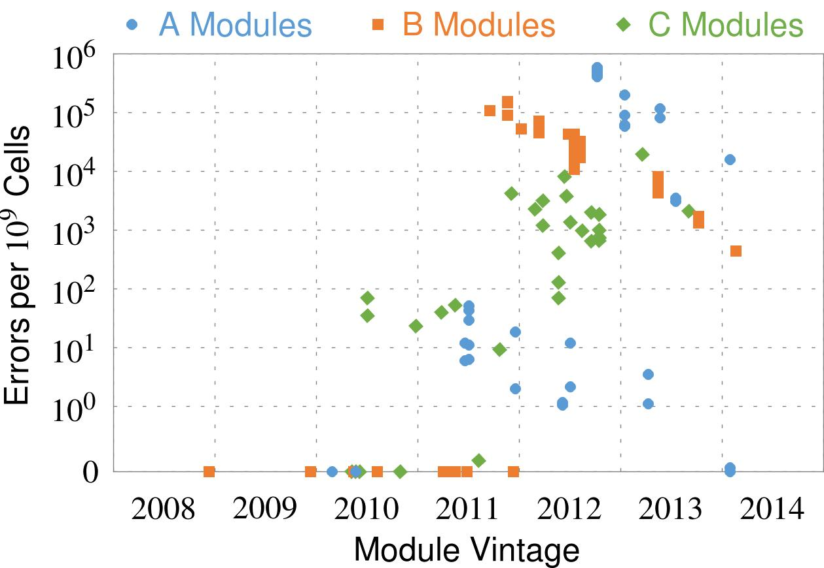
Recent DRAM Is More Vulnerable
Notes:
In this figure, the x-axis is the module manufacture date. And the y-axis is the number of errors in a module, normalized to one billion cells. In 2008 and 2009, there are no errors. But, in 2010, we first start to see errors in C modules. After 2010, the errors start to proliferate. For A and B modules, we first start to see errors in 2011. In particular, all modules from 2012 and 2013 are vulnerable.

Slide 35
Recent DRAM Is More Vulnerable
First
Appearance
Notes:
In this figure, the x-axis is the module manufacture date. And the y-axis is the number of errors in a module, normalized to one billion cells. In 2008 and 2009, there are no errors. But, in 2010, we first start to see errors in C modules. After 2010, the errors start to proliferate. For A and B modules, we first start to see errors in 2011. In particular, all modules from 2012 and 2013 are vulnerable.

Slide 36
Recent DRAM Is More Vulnerable
First
Appearance
All modules from 2012–2013 are vulnerable
Notes:
In this figure, the x-axis is the module manufacture date. And the y-axis is the number of errors in a module, normalized to one billion cells. In 2008 and 2009, there are no errors. But, in 2010, we first start to see errors in C modules. After 2010, the errors start to proliferate. For A and B modules, we first start to see errors in 2011. In particular, all modules from 2012 and 2013 are vulnerable.

Slide 37
Why Is This Happening?
DRAM cells are too close to each other!
They are not electrically isolated from each other
Access to one cell affects the value in nearby cells
due to electrical interference between
the cells
wires used for accessing the cells
Also called cell-to-cell coupling/interference
Example: When we activate (apply high voltage) to a row, an adjacent row gets slightly activated as well
Vulnerable cells in that slightly-activated row lose a little bit of charge
If row hammer happens enough times, charge in such cells gets drained

Slide 38
Higher-Level Implications
This simple circuit-level failure mechanism has enormous implications on upper layers of the transformation hierarchy
Problem
Problem
Algorithm
Algorithm
Program/Language
User
Program/Language
Runtime System
(VM, OS, MM)
Runtime System
(VM, OS, MM)
ISA (Architecture)
ISA
Microarchitecture
Microarchitecture
Logic
Logic
Devices
Devices
Electrons
Electrons

Slide 39
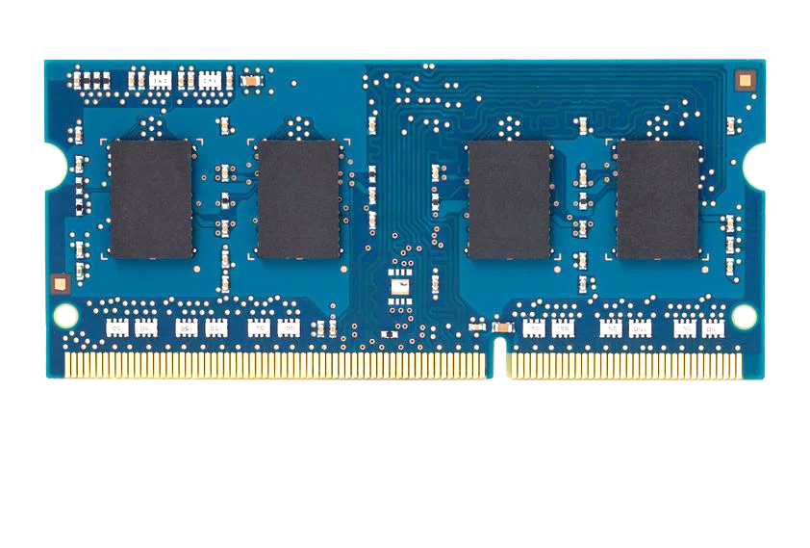
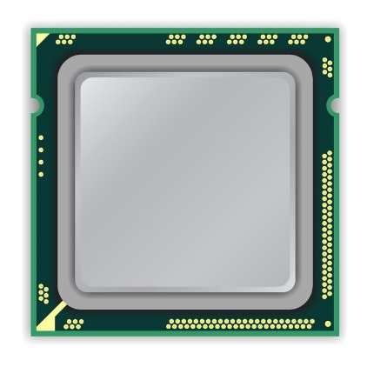
A Simple Program Can Induce Many Errors
CPU
DRAM Module
loop:
mov (X), %eax
mov (Y), %ebx
clflush (X)
clflush (Y)
mfence
jmp loop
X
Y
Download from: https://github.com/CMU-SAFARI/rowhammer
Notes:
We demonstrate the errors on multiple x86 systems. Shown to the bottom-left is a “disturbance kernel”. When executed, it forces two rows to be opened and closed one after the other – over and over again. Consequently, it induces many errors in the module.

Slide 40
A Simple Program Can Induce Many Errors
CPU
DRAM Module
Avoid cache hits
Flush X from cache
Avoid row hits to X
Read Y in another row
X
Y
Download from: https://github.com/CMU-SAFARI/rowhammer
Notes:
We demonstrate the errors on multiple x86 systems. Shown to the bottom-left is a “disturbance kernel”. When executed, it forces two rows to be opened and closed one after the other – over and over again. Consequently, it induces many errors in the module.

Slide 41
A Simple Program Can Induce Many Errors
CPU
DRAM Module
loop:
mov (X), %eax
mov (Y), %ebx
clflush (X)
clflush (Y)
mfence
jmp loop
X
Y
Download from: https://github.com/CMU-SAFARI/rowhammer
Notes:
We demonstrate the errors on multiple x86 systems. Shown to the bottom-left is a “disturbance kernel”. When executed, it forces two rows to be opened and closed one after the other – over and over again. Consequently, it induces many errors in the module.

Slide 42
A Simple Program Can Induce Many Errors
CPU
DRAM Module
loop:
mov (X), %eax
mov (Y), %ebx
clflush (X)
clflush (Y)
mfence
jmp loop
X
Y
Download from: https://github.com/CMU-SAFARI/rowhammer
Notes:
We demonstrate the errors on multiple x86 systems. Shown to the bottom-left is a “disturbance kernel”. When executed, it forces two rows to be opened and closed one after the other – over and over again. Consequently, it induces many errors in the module.

Slide 43
A Simple Program Can Induce Many Errors
CPU
DRAM Module
loop:
mov (X), %eax
mov (Y), %ebx
clflush (X)
clflush (Y)
mfence
jmp loop
X
Y
Download from: https://github.com/CMU-SAFARI/rowhammer
Notes:
We demonstrate the errors on multiple x86 systems. Shown to the bottom-left is a “disturbance kernel”. When executed, it forces two rows to be opened and closed one after the other – over and over again. Consequently, it induces many errors in the module.

Slide 44
Observed Errors in Real Systems
A real reliability & security issue
CPU Architecture | Errors | Access-Rate
Intel Haswell (2013) | 22.9K | 12.3M/sec
Intel Ivy Bridge (2012) | 20.7K | 11.7M/sec
Intel Sandy Bridge (2011) | 16.1K | 11.6M/sec
AMD Piledriver (2012) | 59 | 6.1M/sec
Kim+, “Flipping Bits in Memory Without Accessing Them: An Experimental Study of DRAM Disturbance Errors,” ISCA 2014.
Notes:
When we executed the code on four different processors, all four of them yielded errors. Intel Haswell has the most errors, at 23 thousand, because it has the highest rate of accessing DRAM.
Later on, I’ll show that we can induce as many as ten million disturbance errors in a more controlled environment.
From this, we conclude that disturbance errors are a serious reliability issue.

Slide 45
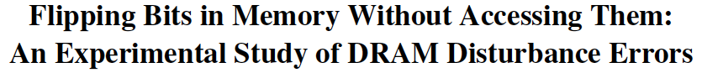
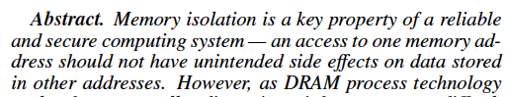
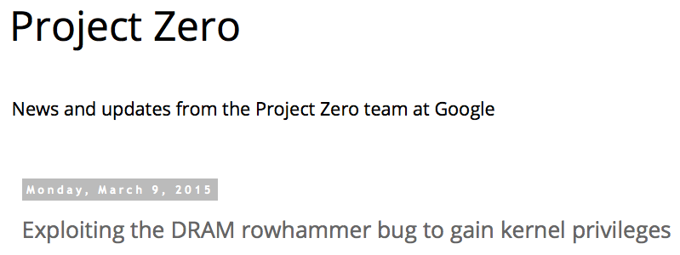
One Can Take Over an Otherwise-Secure System
Flipping Bits in Memory Without Accessing Them: An Experimental Study of DRAM Disturbance Errors (Kim et al., ISCA 2014)
Exploiting the DRAM rowhammer bug to gain kernel privileges (Seaborn, 2015)

Slide 46
RowHammer Security Attack Example
“Rowhammer” is a problem with some recent DRAM devices in which repeatedly accessing a row of memory can cause bit flips in adjacent rows (Kim et al., ISCA 2014).
Flipping Bits in Memory Without Accessing Them: An Experimental Study of DRAM Disturbance Errors (Kim et al., ISCA 2014)
We tested a selection of laptops and found that a subset of them exhibited the problem.
We built two working privilege escalation exploits that use this effect.
Exploiting the DRAM rowhammer bug to gain kernel privileges (Seaborn, 2015)
One exploit uses rowhammer-induced bit flips to gain kernel privileges on x86-64 Linux when run as an unprivileged userland process.
When run on a machine vulnerable to the rowhammer problem, the process was able to induce bit flips in page table entries (PTEs).
It was able to use this to gain write access to its own page table, and hence gain read-write access to all of physical memory.
Exploiting the DRAM rowhammer bug to gain kernel privileges (Seaborn, 2015)

Slide 47
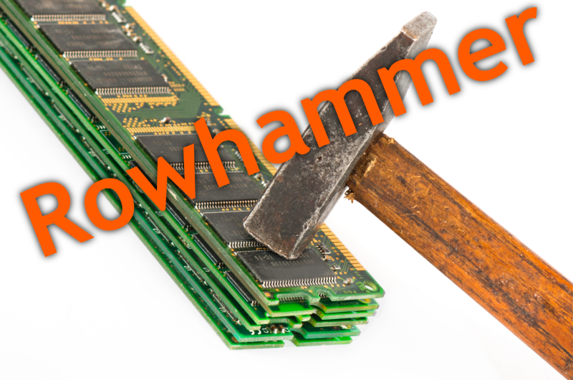
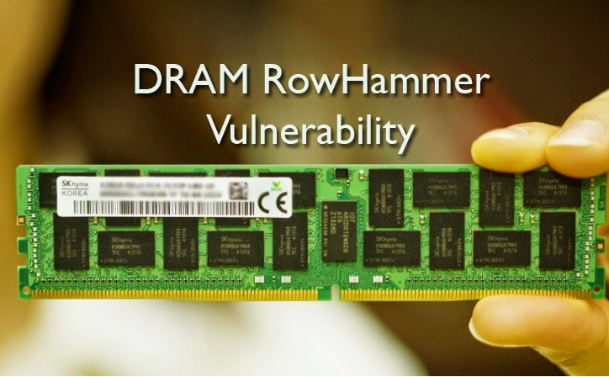
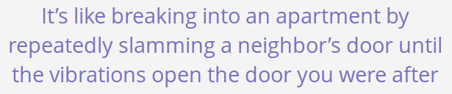
Security Implications
Notes:
Picture from the article:
http://thehackernews.com/2015/03/dram-rowhammer-vulnerability.html

Slide 48
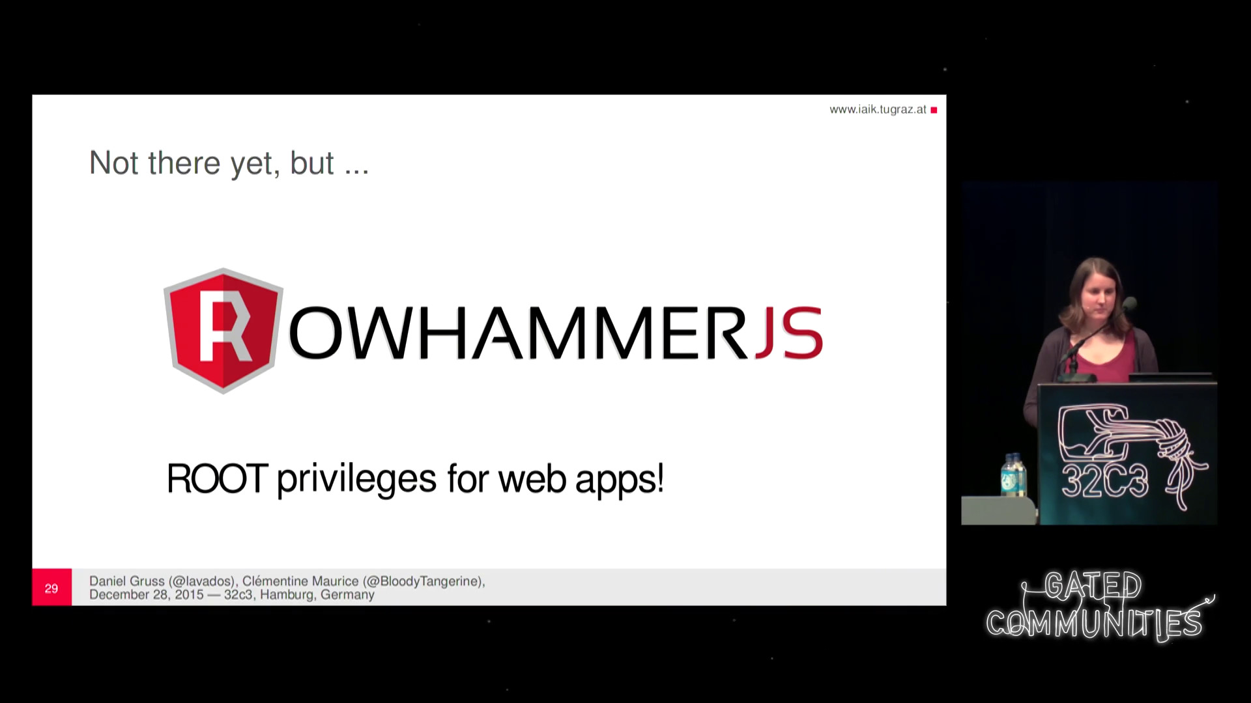
More Security Implications
“We can gain unrestricted access to systems of website visitors.”
Rowhammer.js: A Remote Software-Induced Fault Attack in JavaScript (DIMVA’16)
Source: https://lab.dsst.io/32c3-slides/7197.html

Slide 49

More Security Implications
“Can gain control of a smart phone deterministically”
Drammer: Deterministic Rowhammer Attacks on Mobile Platforms, CCS’16
Source: https://fossbytes.com/drammer-rowhammer-attack-android-root-devices/

Slide 50
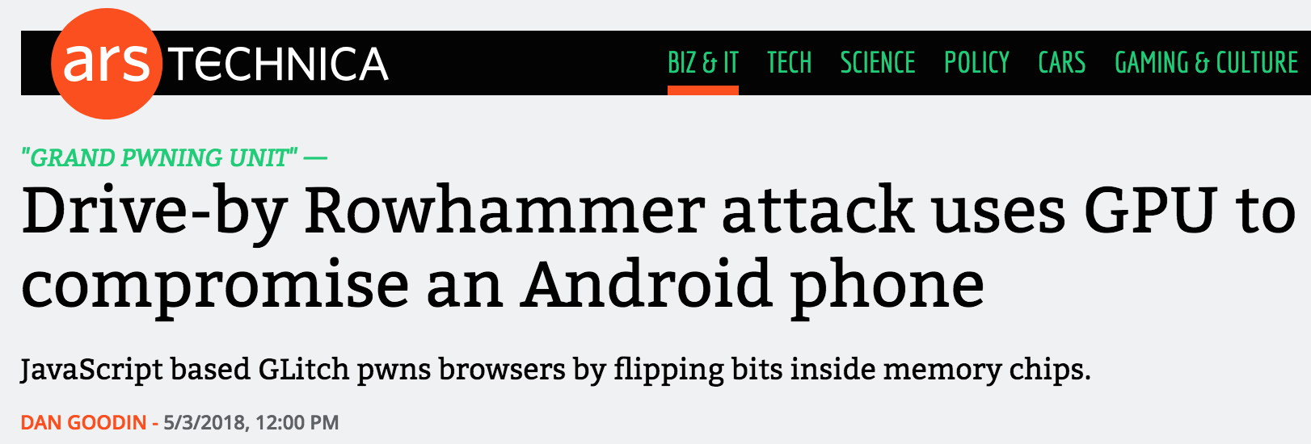

More Security Implications (III)
Using an integrated GPU in a mobile system to remotely escalate privilege via the WebGL interface

Slide 51
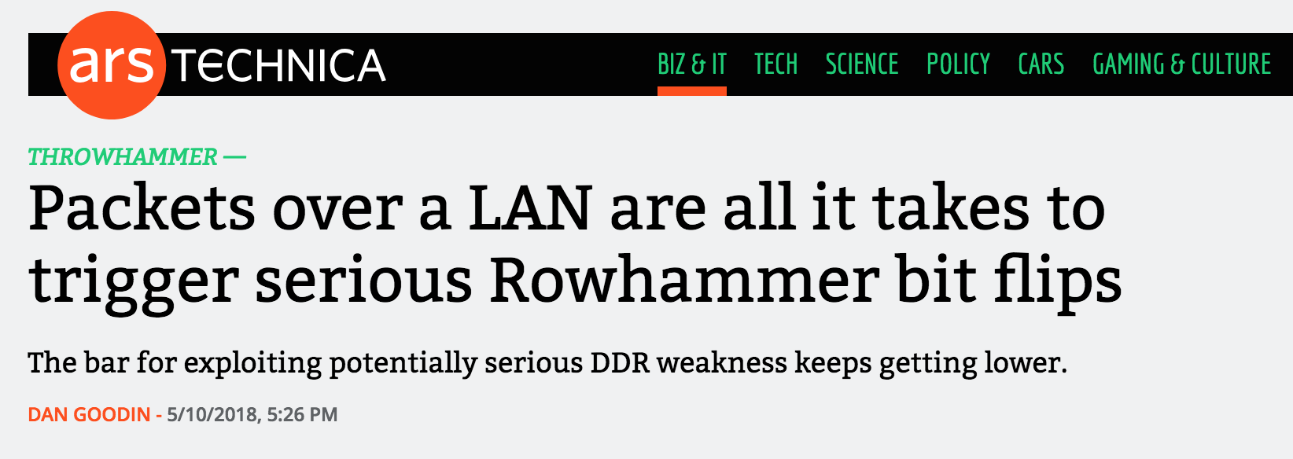
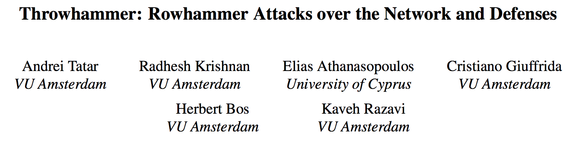
More Security Implications (IV)
Rowhammer over RDMA (I)

Slide 52


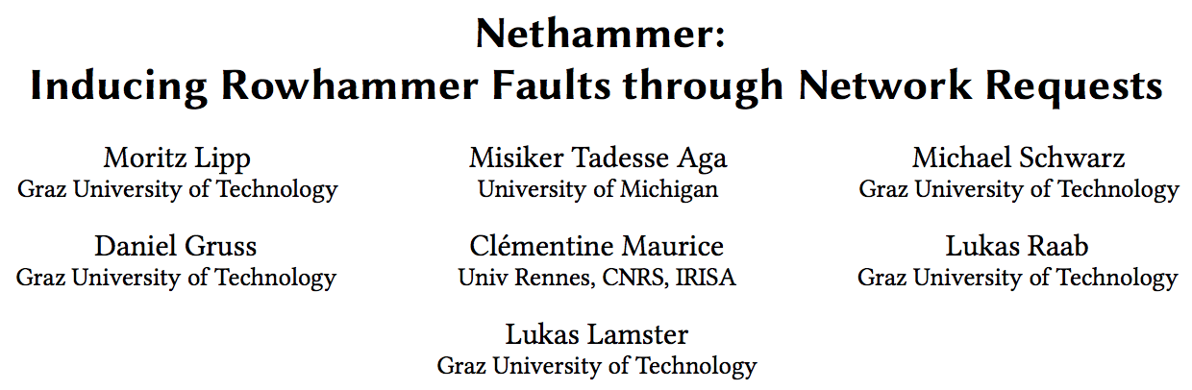
More Security Implications (V)
Rowhammer over RDMA (II)

Slide 53

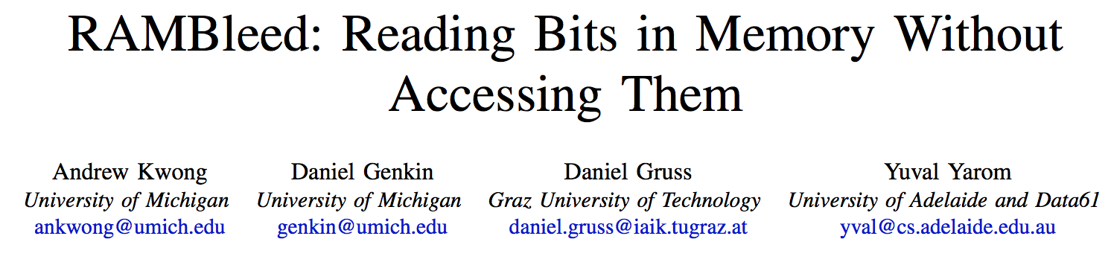
More Security Implications (VI)
IEEE S&P 2020

Slide 54

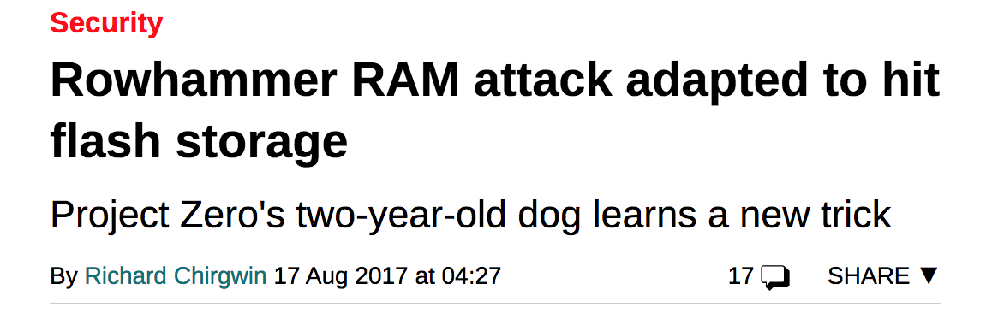
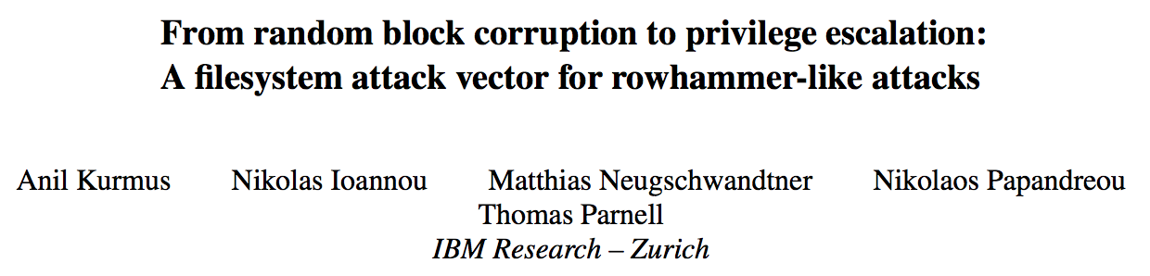
More Security Implications (VII)
Rowhammer on MLC NAND Flash (based on [Cai+, HPCA 2017])

Slide 55
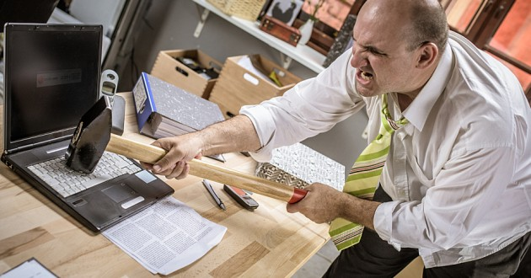
More Security Implications?

Slide 56
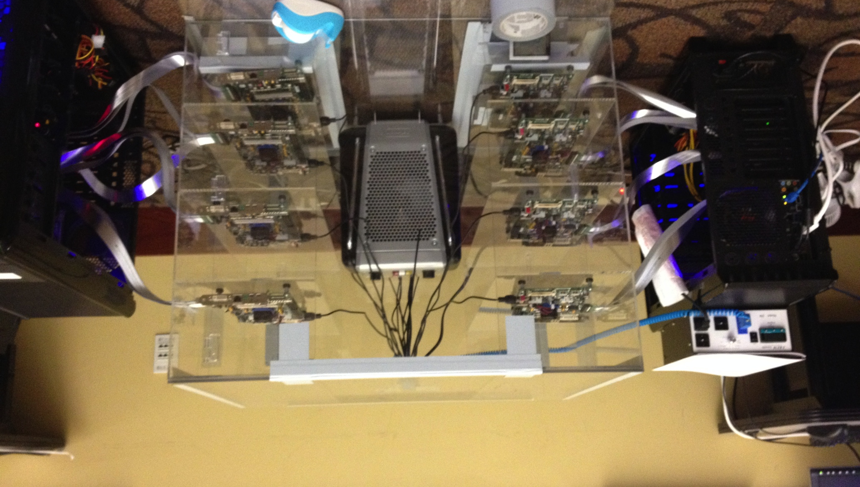
Where RowHammer Was Discovered…
Temperature
Controller
FPGAs
Heater
FPGAs
PC
Kim+, “Flipping Bits in Memory Without Accessing Them: An Experimental Study of DRAM Disturbance Errors,” ISCA 2014.

Slide 57
How Do We Fix The Problem?

Slide 58
Some Potential Solutions
Cost
Make better DRAM chips
Power, Performance
Refresh frequently
Cost, Power
Sophisticated Error Correction
Cost, Power, Complexity
Access counters
Notes:
Here is a list of four potential solutions to disturbance errors: making better DRAM chips, refreshing more frequently, employing sophisticated ECC schemes, and using hardware counters to track the number of accesses to different rows.
However, all of these solutions incur a large overhead in terms cost, power, performance, and/or complexity.

Slide 59
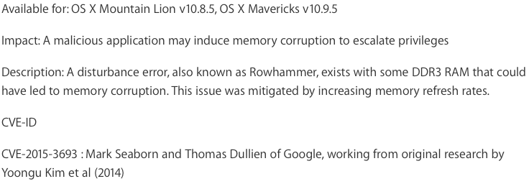
Apple’s Security Patch for RowHammer
https://support.apple.com/en-gb/HT204934
HP, Lenovo, and many other vendors released similar patches

Slide 60
A Cheaper Solution
PARA: Probabilistic Adjacent Row Activation
Key Idea
After closing a row, we activate (i.e., refresh) one of its neighbors with a low probability: p = 0.005
Reliability Guarantee
When p=0.005, errors in one year: 9.4×10⁻¹⁴
By adjusting the value of p, we can provide an arbitrarily strong protection against errors
Notes:
We provide a more efficient solution, called PARA, which stands for probabilistic adjacent row activation.
The key idea is thus: after closing a row, we activate (i.e., refresh) one of its neighbors with a low probability, for example, p equal to 0.005.
PARA provides a strong reliability guarantee even under the worst-case access patterns to DRAM. When we set p to 0.005, the expected number of errors in one year is 9.4 times 10 to the negative 14. This probability is much lower the failure rate of other hardware components, for example, the hard-disk drive.
And by adjusting the value of p, PARA can provide an arbitrarily strong-degree of protection against errors.

Slide 61
Some Thoughts on RowHammer
A simple hardware failure mechanism can create a widespread system security vulnerability
How to find, exploit and fix the vulnerability requires a strong understanding across the transformation layers
And, a strong understanding of tools available to you
Fixing needs to happen for two types of chips
Existing chips (already in the field)
Future chips
Mechanisms for fixing are different between the two types

Slide 62
Aside: Byzantine Failures
This class of failures is known as Byzantine failures
Characterized by
Undetected erroneous computation
Opposite of “fail fast (with an error or no result)”
“erroneous” can be “malicious” (intent is the only distinction)
Very difficult to detect and confine Byzantine failures
Do all you can to avoid them
Lamport et al., “The Byzantine Generals Problem,” ACM TOPLAS 1982.
Slide credit: Mahadev Satyanarayanan, CMU, 15-440, Spring 2015

Slide 63
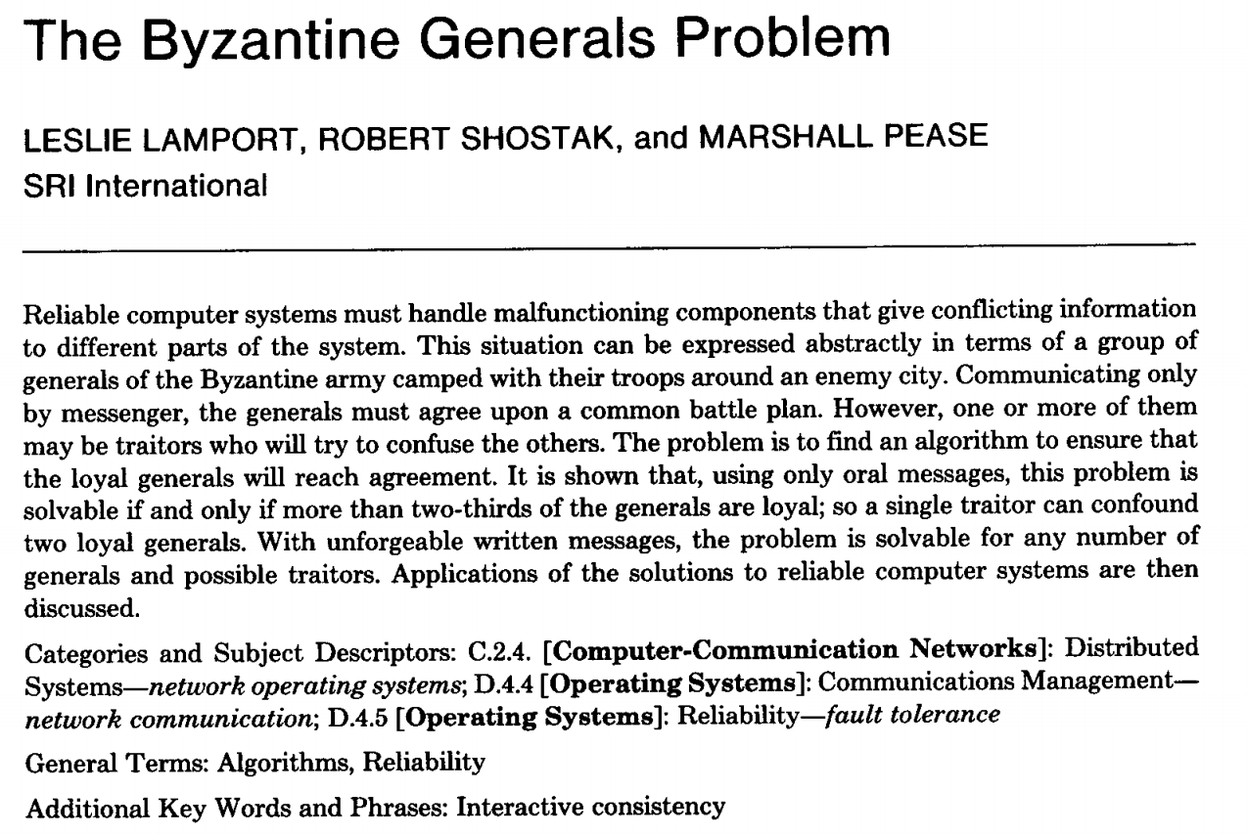
Aside: Byzantine Generals Problem
https://dl.acm.org/citation.cfm?id=357176

Slide 64
Really Interested?
Our first detailed study: Rowhammer analysis and solutions (June 2014)
Yoongu Kim, Ross Daly, Jeremie Kim, Chris Fallin, Ji Hye Lee, Donghyuk Lee, Chris Wilkerson, Konrad Lai, and Onur Mutlu, "Flipping Bits in Memory Without Accessing Them: An Experimental Study of DRAM Disturbance Errors" Proceedings of the 41st International Symposium on Computer Architecture (ISCA), Minneapolis, MN, June 2014. [Slides (pptx) (pdf)] [Lightning Session Slides (pptx) (pdf)] [Source Code and Data]
Our Source Code to Induce Errors in Modern DRAM Chips (June 2014)
https://github.com/CMU-SAFARI/rowhammer
Google Project Zero’s Attack to Take Over a System (March 2015)
Exploiting the DRAM rowhammer bug to gain kernel privileges (Seaborn+, 2015)
https://github.com/google/rowhammer-test
Double-sided Rowhammer

Slide 65
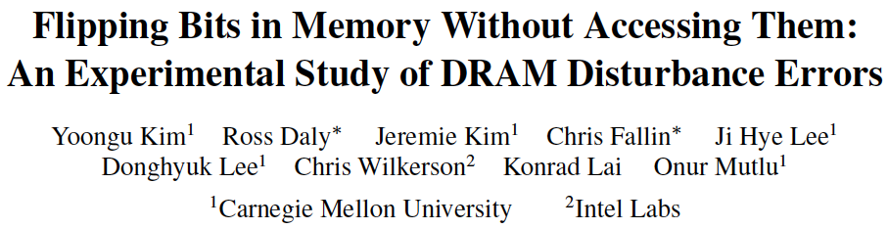
RowHammer: Five Years Ago…
Yoongu Kim, Ross Daly, Jeremie Kim, Chris Fallin, Ji Hye Lee, Donghyuk Lee, Chris Wilkerson, Konrad Lai, and Onur Mutlu, "Flipping Bits in Memory Without Accessing Them: An Experimental Study of DRAM Disturbance Errors" Proceedings of the 41st International Symposium on Computer Architecture (ISCA), Minneapolis, MN, June 2014. [Slides (pptx) (pdf)] [Lightning Session Slides (pptx) (pdf)] [Source Code and Data]

Slide 66
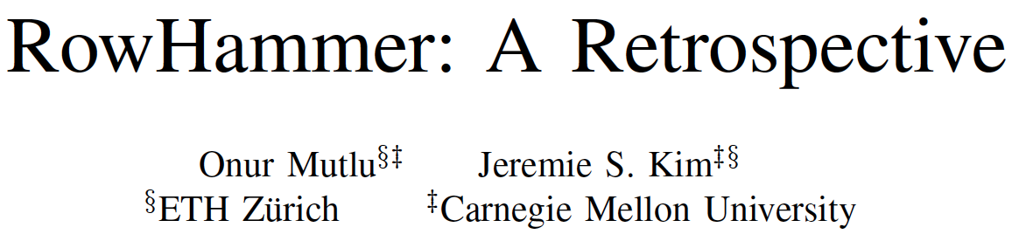
RowHammer: Now and Beyond…
Onur Mutlu and Jeremie Kim, "RowHammer: A Retrospective" IEEE Transactions on Computer-Aided Design of Integrated Circuits and Systems (TCAD) Special Issue on Top Picks in Hardware and Embedded Security, 2019. [Preliminary arXiv version]

Slide 67
Takeaway
Breaking the abstraction layers (between components and transformation hierarchy levels)
and knowing what is underneath
enables you to understand and solve problems

Slide 68
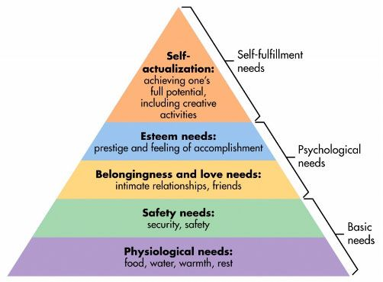
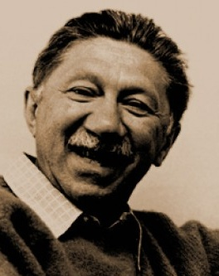
Maslow’s (Human) Hierarchy of Needs
Maslow, “A Theory of Human Motivation,”
Psychological Review, 1943.
Maslow, “A Theory of Human Motivation,”
Psychological Review, 1943.
Maslow, “Motivation and Personality,”
Book, 1954-1970.
We need to start with reliability and security…
Source: https://www.simplypsychology.org/maslow.html
Source: By User:Factoryjoe - Mazlow's Hierarchy of Needs.svg, CC BY-SA 3.0, https://commons.wikimedia.org/w/index.php?curid=7964065

Slide 69
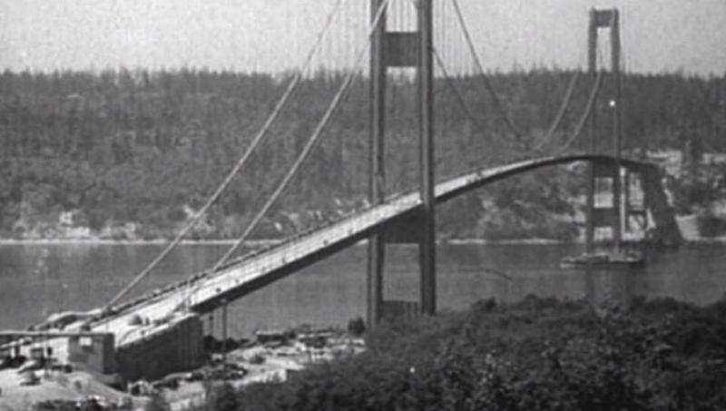
How Reliable/Secure/Safe is This Bridge?
Source: http://www.technologystudent.com/struct1/tacom1.png

Slide 70
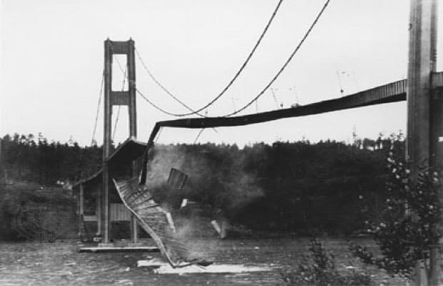
Collapse of the “Galloping Gertie”
Source: AP
http://www.wsdot.wa.gov/tnbhistory/connections/connections3.htm

Slide 71
How Secure Are These People?
Security is about preventing unforeseen consequences
Source: https://s-media-cache-ak0.pinimg.com/originals/48/09/54/4809543a9c7700246a0cf8acdae27abf.jpg

Slide 72
RowHammer: Retrospective
New mindset that has enabled a renewed interest in HW security attack research:
Real (memory) chips are vulnerable, in a simple and widespread manner → this causes real security problems
Hardware reliability → security connection is now mainstream discourse
Many new RowHammer attacks…
Tens of papers in top security venues
More to come as RowHammer is getting worse (DDR4 & beyond)
Many new RowHammer solutions…
Apple security release; Memtest86 updated
Many solution proposals in top venues (latest in ISCA 2019)
Principled system-DRAM co-design (in original RowHammer paper)
More to come…

Slide 73
Perhaps Most Importantly…
RowHammer enabled a shift of mindset in mainstream security researchers
General-purpose hardware is fallible, in a widespread manner
Its problems are exploitable
This mindset has enabled many systems security researchers to examine hardware in more depth
And understand HW’s inner workings and vulnerabilities
It is no coincidence that two of the groups that discovered Meltdown and Spectre heavily worked on RowHammer attacks before
More to come…

Slide 74
For More on RowHammer…
Onur Mutlu and Jeremie Kim, "RowHammer: A Retrospective" IEEE Transactions on Computer-Aided Design of Integrated Circuits and Systems (TCAD) Special Issue on Top Picks in Hardware and Embedded Security, 2019. [Preliminary arXiv version]

Slide 75
Mystery #3: DRAM Refresh

Slide 76
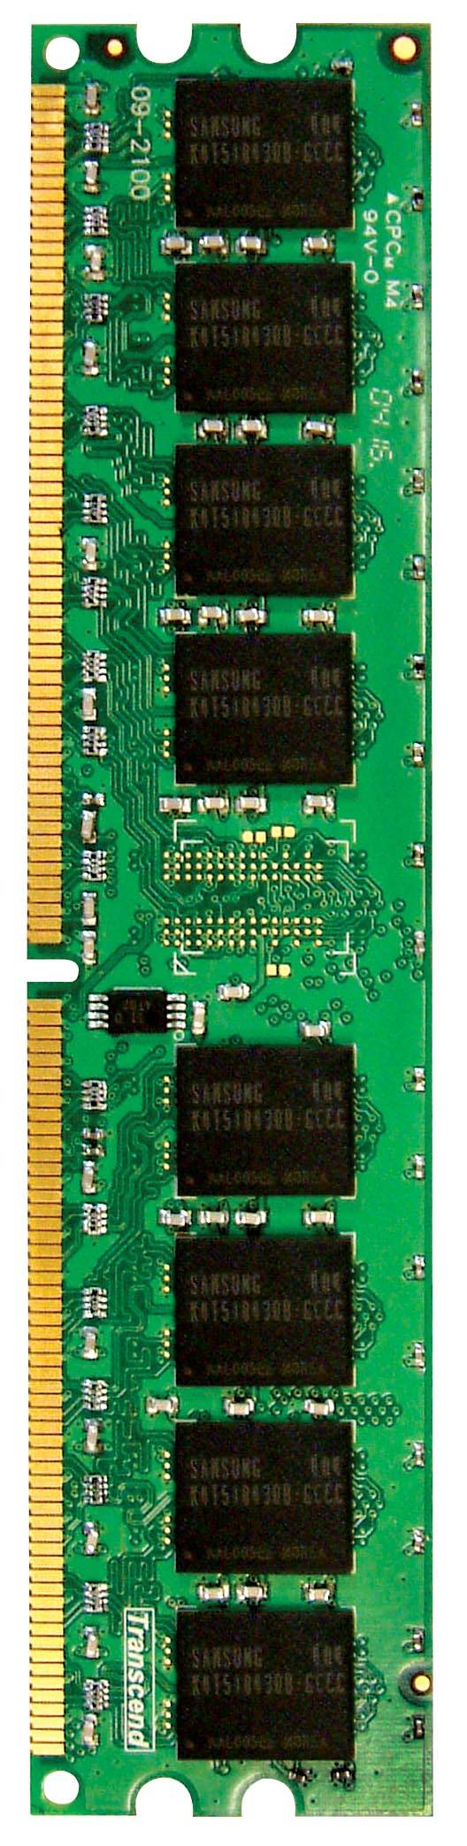
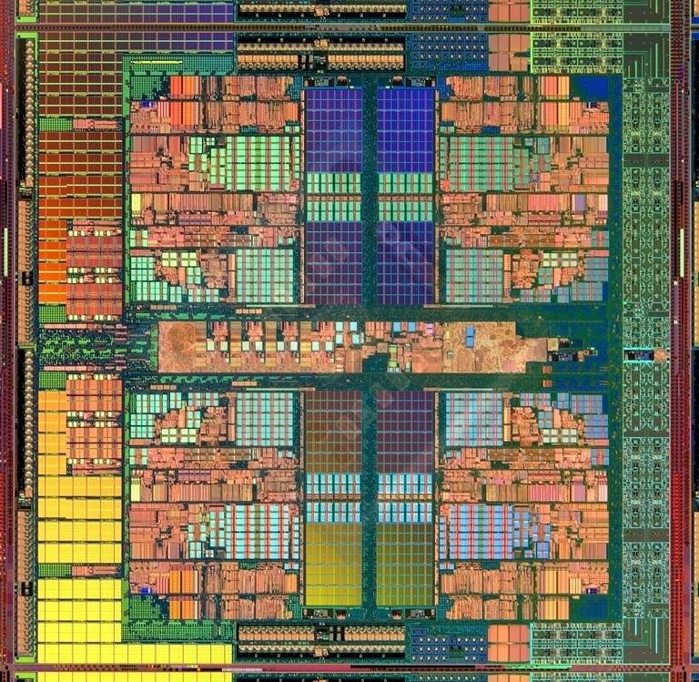
DRAM in the System
Multi-Core
Chip
CORE 0
L2 CACHE 1
CORE 1
L2 CACHE 0
SHARED L3 CACHE
DRAM INTERFACE
DRAM MEMORY CONTROLLER
DRAM BANKS
L2 CACHE 2
CORE 3
CORE 2
L2 CACHE 3
*Die photo credit: AMD Barcelona

Slide 77
A DRAM Cell
A DRAM cell consists of a capacitor and an access transistor
It stores data in terms of charge status of the capacitor
A DRAM chip consists of (10s of 1000s of) rows of such cells
wordline
(row enable)
bitline
bitline
bitline
bitline
bitline

Slide 78
DRAM Refresh
DRAM capacitor charge leaks over time
The memory controller needs to refresh each row periodically to restore charge
Activate each row every N ms
Typical N = 64 ms
Downsides of refresh
-- Energy consumption: Each refresh consumes energy
-- Performance degradation: DRAM rank/bank unavailable while refreshed
-- QoS/predictability impact: (Long) pause times during refresh
-- Refresh rate limits DRAM capacity scaling

Slide 79
First, Some Analysis
Imagine a system with 1 ExaByte DRAM (2^60 bytes)
Assume a row size of 8 KiloBytes (2^13 bytes)
How many rows are there?
How many refreshes happen in 64ms?
What is the total power consumption of DRAM refresh?
What is the total energy consumption of DRAM refresh during a day?
A good exercise… Optional homework...
Brownie points from me if you do it...

Slide 80
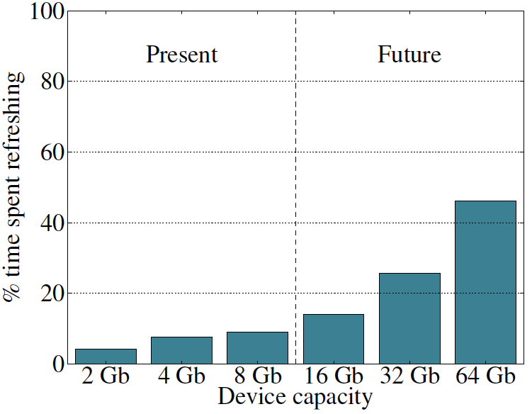
Refresh Overhead: Performance
46%
8%
Liu et al., “RAIDR: Retention-Aware Intelligent DRAM Refresh,” ISCA 2012.

Slide 81
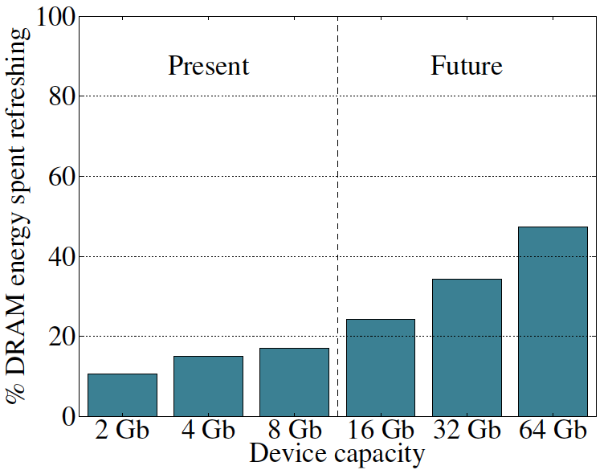
Refresh Overhead: Energy
47%
15%
Liu et al., “RAIDR: Retention-Aware Intelligent DRAM Refresh,” ISCA 2012.

Slide 82
How Do We Solve the Problem?
Observation: All DRAM rows are refreshed every 64ms.
Critical thinking: Do we need to refresh all rows every 64ms?
What if we knew what happened underneath and exposed that information to upper layers?

Slide 83
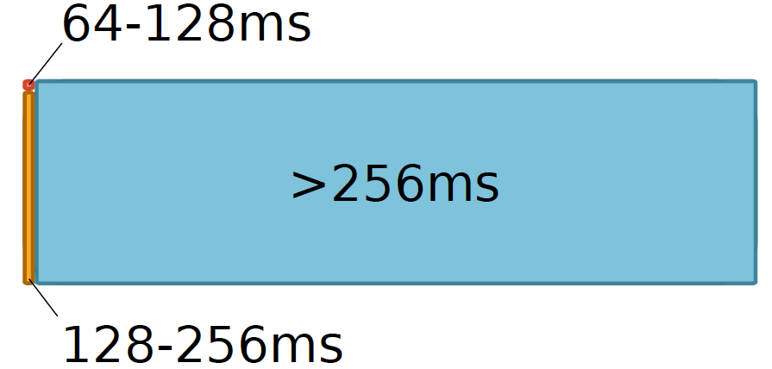
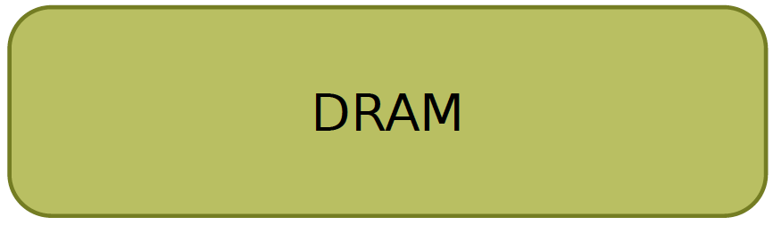
Underneath: Retention Time Profile of DRAM
Liu et al., “RAIDR: Retention-Aware Intelligent DRAM Refresh,” ISCA 2012.

Slide 84
Digital Design & Computer Arch. Lecture 2b: Mysteries in Comp. Arch.
Prof. Onur Mutlu
ETH Zürich
Spring 2020
21 February 2020

Slide 85
We Did Not Cover the Following Slides in Lecture 2

Slide 86
Aside: Why Do We Have Such a Profile?
Answer: Manufacturing is not perfect
Not all DRAM cells are exactly the same
Some are more leaky than others
This is called Manufacturing Process Variation

Slide 87
Opportunity: Taking Advantage of This Profile
Assume we know the retention time of each row exactly
What can we do with this information?
Who do we expose this information to?
How much information do we expose?
Affects hardware/software overhead, power consumption, verification complexity, cost
How do we determine this profile information?
Also, who determines it?
Problem
Algorithm
Program/Language
Runtime System
(VM, OS, MM)
ISA (Architecture)
Microarchitecture
Logic
Devices
Electrons

Slide 88
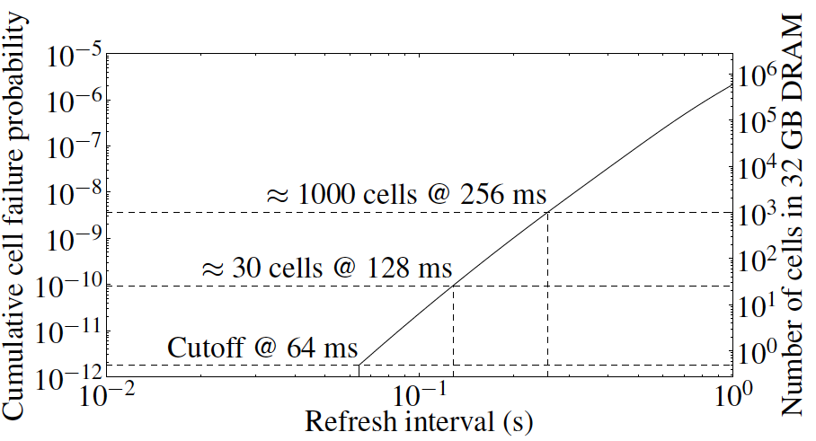
Retention Time of DRAM Rows
Observation: Overwhelming majority of DRAM rows can be refreshed much less often without losing data
Can we exploit this to reduce refresh operations at low cost?
Only ~1000 rows in 32GB DRAM need refresh every 64 ms,
but we refresh all rows every 64ms
Key Idea of RAIDR: Refresh weak rows more frequently,
all other rows less frequently
Liu et al., “RAIDR: Retention-Aware Intelligent DRAM Refresh,” ISCA 2012.

Slide 89
RAIDR: Eliminating Unnecessary DRAM Refreshes
Liu, Jaiyen, Veras, Mutlu,
RAIDR: Retention-Aware Intelligent DRAM Refresh
ISCA 2012.

Slide 90
RAIDR: Mechanism
1. Profiling: Identify the retention time of all DRAM rows
→ can be done at design time or during operation
2. Binning: Store rows into bins by retention time
→ use Bloom Filters for efficient and scalable storage
3. Refreshing: Memory controller refreshes rows in different bins at different rates
→ check the bins to determine refresh rate of a row
1.25KB storage in controller for 32GB DRAM memory
Liu et al., “RAIDR: Retention-Aware Intelligent DRAM Refresh,” ISCA 2012.

Slide 91
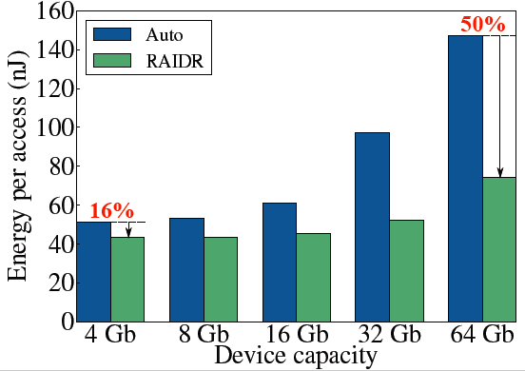
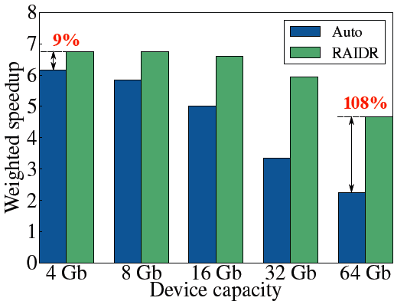
RAIDR: Results and Takeaways
System: 32GB DRAM, 8-core; Various workloads
RAIDR hardware cost: 1.25 kB (2 Bloom filters)
Refresh reduction: 74.6%
Dynamic DRAM energy reduction: 16%
Idle DRAM power reduction: 20%
Performance improvement: 9%
Benefits increase as DRAM scales in density

Slide 92
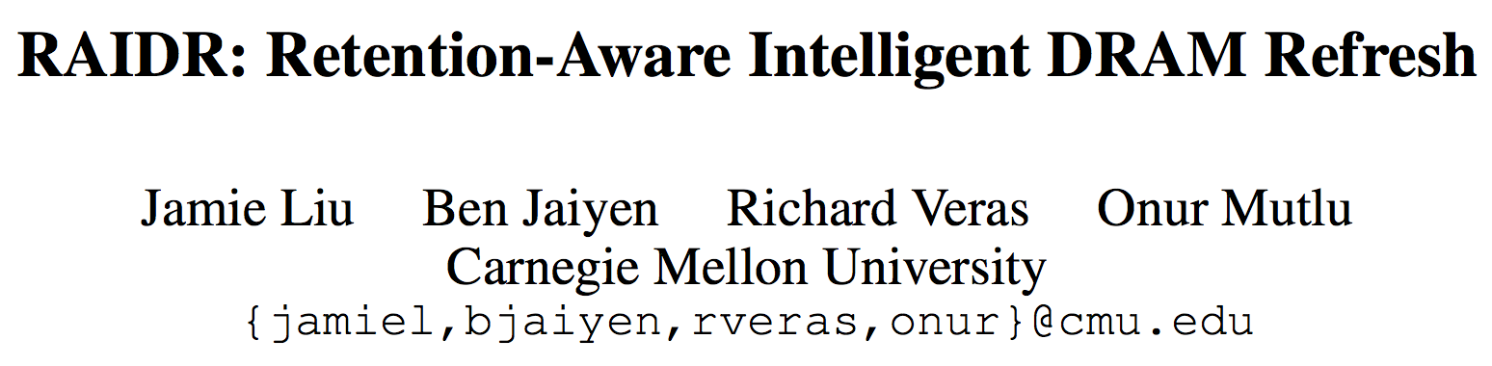
Reading for the Really Interested
Jamie Liu, Ben Jaiyen, Richard Veras, and Onur Mutlu, "RAIDR: Retention-Aware Intelligent DRAM Refresh" Proceedings of the 39th International Symposium on Computer Architecture (ISCA), Portland, OR, June 2012. Slides (pdf)

Slide 93
Really Interested? … Further Readings
Onur Mutlu, "Memory Scaling: A Systems Architecture Perspective" Technical talk at MemCon 2013 (MEMCON), Santa Clara, CA, August 2013. Slides (pptx) (pdf) Video
Kevin Chang, Donghyuk Lee, Zeshan Chishti, Alaa Alameldeen, Chris Wilkerson, Yoongu Kim, and Onur Mutlu, "Improving DRAM Performance by Parallelizing Refreshes with Accesses" Proceedings of the 20th International Symposium on High-Performance Computer Architecture (HPCA), Orlando, FL, February 2014. Slides (pptx) (pdf)

Slide 94
Takeaway
Breaking the abstraction layers (between components and transformation hierarchy levels)
and knowing what is underneath
enables you to understand and solve problems

Slide 95
Mystery #4: Memory Performance Attacks

Slide 96
Multi-Core Systems
Multi-Core
Chip
CORE 0
L2 CACHE 1
CORE 1
L2 CACHE 0
SHARED L3 CACHE
DRAM INTERFACE
DRAM MEMORY CONTROLLER
DRAM BANKS
L2 CACHE 2
CORE 3
CORE 2
L2 CACHE 3
*Die photo credit: AMD Barcelona

Slide 97
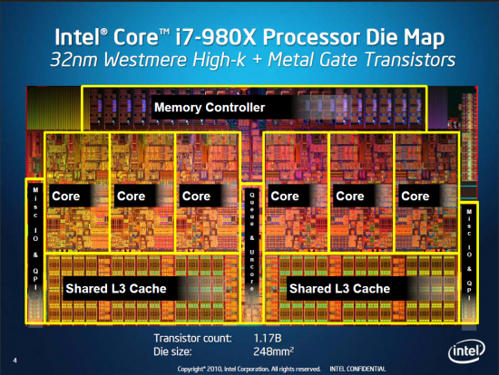
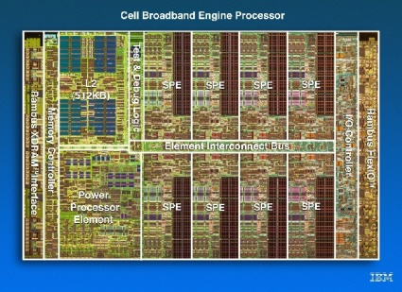
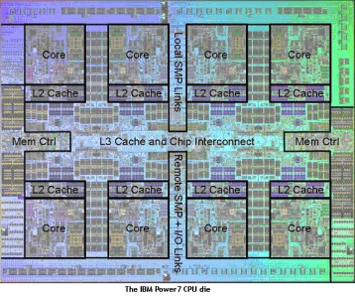
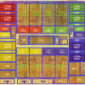
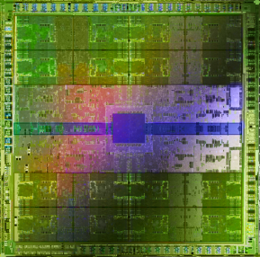
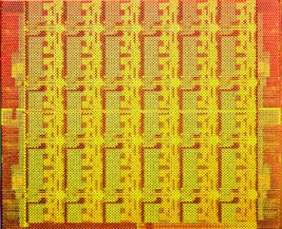
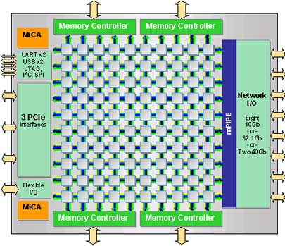
A Trend: Many Cores on Chip
Simpler and lower power than a single large core
Parallel processing on single chip → faster, new applications
Intel Core i7 8 cores
IBM Cell BE 8+1 cores
IBM POWER7
8 cores
AMD Barcelona
4 cores
Nvidia Fermi
448 “cores”
Intel SCC
48 cores, networked
Tilera TILE Gx
100 cores, networked
Sun Niagara II
8 cores

Slide 98
Many Cores on Chip
What we want:
N times the system performance with N times the cores
What do we get today?

Slide 99
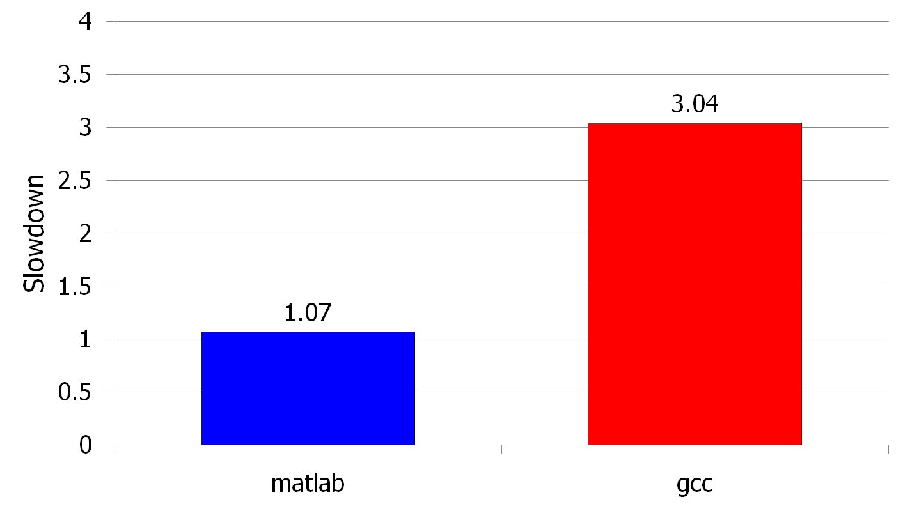
Unexpected Slowdowns in Multi-Core
High priority
Memory Performance Hog
Low priority
(Core 0)
(Core 1)
Moscibroda and Mutlu, “Memory performance attacks: Denial of memory service
in multi-core systems,” USENIX Security 2007.
Notes:
What kind of performance do we expect when we run two applications on a multi-core system? To answer this question, we performed an experiment. We took two applications we cared about, ran them together on different cores in a dual-core system, and measured their slowdown compared to when each is run alone on the same system. This graph shows the slowdown each app experienced. (DATA explanation…)
Why do we get such a large disparity in the slowdowns?
Is it the priorities? No. We went back and gave high priority to gcc and low priority to matlab. The slowdowns did not change at all. Neither the software or the hardware enforced the priorities.
Is it the contention in the disk? We checked for this possibility, but found that these applications did not have any disk accesses in the steady state. They both fit in the physical memory and therefore did not interfere in the disk.
What is it then? Why do we get such large disparity in slowdowns in a dual core system?
I will call such an application a “memory performance hog”
Now, let me tell you why this disparity in slowdowns happens.
Is it that there are other applications or the OS interfering with gcc, stealing its time quantums? No.

Slide 100
Three Questions
Can you figure out why the applications slow down if you do not know the underlying system and how it works?
Can you figure out why there is a disparity in slowdowns if you do not know how the system executes the programs?
Can you fix the problem without knowing what is happening “underneath”?

Slide 101
Three Questions
Why is there any slowdown?
Why is there a disparity in slowdowns?
How can we solve the problem if we do not want that disparity?
What do we want (the system to provide)?

Slide 102
Why Is This Important?
We want to execute applications in parallel in multi-core systems → consolidate more and more
Cloud computing
Mobile phones
We want to mix different types of applications together
those requiring QoS guarantees (e.g., video, pedestrian detection)
those that are important but less so
those that are less important
We want the system to be controllable and high performance

Slide 103
Why the Disparity in Slowdowns?
CORE 1
CORE 2
Multi-Core
Chip
L2
CACHE
L2
CACHE
INTERCONNECT
Shared DRAM
Memory System
DRAM MEMORY CONTROLLER
DRAM
Bank 0
DRAM
Bank 1
DRAM
Bank 2
DRAM
Bank 3

Slide 104
Why the Disparity in Slowdowns?
CORE 1
gcc
Multi-Core
Chip
matlab
CORE 2
L2
CACHE
L2
CACHE
unfairness
INTERCONNECT
Shared DRAM
Memory System
DRAM MEMORY CONTROLLER
DRAM
Bank 0
DRAM
Bank 1
DRAM
Bank 2
DRAM
Bank 3
Notes:
-In a multi-core chip, different cores share some hardware resources. In particular, they share the DRAM memory system. The shared memory system consists of this and that.
When we run matlab on one core, and gcc on another core, both cores generate memory requests to access the DRAM banks. When these requests arrive at the DRAM controller, the controller favors matlab’s requests over gcc’s requests. As a result, matlab can make progress and continues generating memory requests. These requests are again favored by the DRAM controller over gcc’s requests. Therefore, gcc starves waiting for its requests to be serviced in DRAM whereas matlab makes very quick progress as if it were running alone.
Why does this happen? This is because the algorithms employed by the DRAM controller are unfair.
But, why are these algorithms unfair? Why do they unfairly prioritize matlab accesses?
To understand this, we need to understand how a DRAM bank operates.
Almost all systems today contain multi-core chips
Multi-core systems consist of multiple on-chip cores and caches
Cores share the DRAM memory system
DRAM memory system consists of
DRAM banks that store data (multiple banks to allow parallel accesses)
DRAM memory controller that mediates between cores and DRAM memory
It schedules memory operations generated by cores to DRAM
This talk is about exploiting the unfair algorithms in the memory controllers to perform denial of service to running threads
To understand how this happens, we need to know about how each DRAM bank operates

Slide 105
Digging Deeper: DRAM Bank Operation
Access Address:
(Row 0, Column 0)
Columns
This view of a bank is an abstraction.
Internally, a bank consists of many cells (transistors & capacitors) and other structures that enable access
to cells
(Row 0, Column 1)
(Row 0, Column 85)
(Row 1, Column 0)
Row address 0
Row address 1
Row decoder
Rows
Row Buffer
CONFLICT !
HIT
Row 1
HIT
Row 0
Empty
Column address 0
Column mux
Column address 0
Column address 1
Column address 85
Data

Slide 106
DRAM Controllers
A row-conflict memory access takes significantly longer than a row-hit access
Current controllers take advantage of this fact
Commonly used scheduling policy (FR-FCFS) [Rixner 2000]*
(1) Row-hit first: Service row-hit memory accesses first
(2) Oldest-first: Then service older accesses first
This scheduling policy aims to maximize DRAM throughput
*Rixner et al., “Memory Access Scheduling,” ISCA 2000.
*Zuravleff and Robinson, “Controller for a synchronous DRAM …,” US Patent 5,630,096, May 1997.

Slide 107
The Problem
Multiple applications share the DRAM controller
DRAM controllers designed to maximize DRAM data throughput
DRAM scheduling policies are unfair to some applications
Row-hit first: unfairly prioritizes apps with high row buffer locality
Threads that keep on accessing the same row
Oldest-first: unfairly prioritizes memory-intensive applications
DRAM controller vulnerable to denial of service attacks
Can write programs to exploit unfairness

Slide 108
A Memory Performance Hog
// initialize large arrays A, B
for (j=0; j<N; j++) {
index = j*linesize;
A[index] = B[index];
…
}
// initialize large arrays A, B
for (j=0; j<N; j++) {
index = rand();
A[index] = B[index];
…
}
streaming
(in sequence)
random
STREAM
RANDOM
Sequential memory access
Very high row buffer locality (96% hit rate)
Memory intensive
Random memory access
Very low row buffer locality (3% hit rate)
Similarly memory intensive
Moscibroda and Mutlu, “Memory Performance Attacks,” USENIX Security 2007.
Notes:
Streaming through memory by performing operations on two 1D arrays.
Sequential memory access
Each access is a cache miss (elements of array larger than a cache line size) → hence, very memory intensive
Link to the real code…

Slide 109
What Does the Memory Hog Do?
Row decoder
T0: Row 0
T0: Row 0
T0: Row 0
T0: Row 0
T0: Row 0
T0: Row 0
T0: Row 0
T1: Row 5
T1: Row 111
T0: Row 0
T1: Row 16
T0: Row 0
Memory Request Buffer
Row 0
Row Buffer
Row 0
Column mux
Row size: 8KB, request size: 64B
128 (8KB/64B) requests of STREAM serviced before a single request of RANDOM
T0: STREAM
T1: RANDOM
Data
Moscibroda and Mutlu, “Memory Performance Attacks,” USENIX Security 2007.
Notes:
Pictorially demonstrate how stream denies memory service to rdarray
Stream continuously accesses columns in row 0 in a streaming manner (streams through a row after opening it)
In other words almost all its requests are row-hits
RDarray’s requests are row-conflicts (no locality)
The DRAM controller reorders streams requests to the open row over other requests (even older ones) to maximize DRAM throughput
Hence, rdarray’s requests do not get serviced as long as stream is issuing requests at a fast-enough rate
In this example, the red thread’s request to another row will not get serviced until stream stops issuing a request to row 0
With those parameters, 128 requests of stream would be serviced before 1 from rdarray
As row-buffer size increases, which is the industry trend, this problem will become more severe
This is not the worst case, but it is easy to construct and understand
Stream falls off the row buffer at some point
I leave it to the listeners to construct a case worse than this (it is possible)

Slide 110
Now That We Know What Happens Underneath
How would you solve the problem?
What is the right place to solve the problem?
Programmer?
System software?
Compiler?
Hardware (Memory controller)?
Hardware (DRAM)?
Circuits?
Two other goals of this course:
Enable you to think critically
Enable you to think broadly
Problem
Algorithm
Program/Language
Runtime System
(VM, OS, MM)
ISA (Architecture)
Microarchitecture
Logic
Devices
Electrons

Slide 111

For the Really Interested…
Thomas Moscibroda and Onur Mutlu, "Memory Performance Attacks: Denial of Memory Service in Multi-Core Systems" Proceedings of the 16th USENIX Security Symposium (USENIX SECURITY), pages 257-274, Boston, MA, August 2007. Slides (ppt)

Slide 112
Really Interested? … Further Readings
Onur Mutlu and Thomas Moscibroda, "Stall-Time Fair Memory Access Scheduling for Chip Multiprocessors" Proceedings of the 40th International Symposium on Microarchitecture (MICRO), pages 146-158, Chicago, IL, December 2007. Slides (ppt)
Onur Mutlu and Thomas Moscibroda, "Parallelism-Aware Batch Scheduling: Enhancing both Performance and Fairness of Shared DRAM Systems”
Proceedings of the 35th International Symposium on Computer Architecture (ISCA) [Slides (ppt)]
Sai Prashanth Muralidhara, Lavanya Subramanian, Onur Mutlu, Mahmut Kandemir, and Thomas Moscibroda, "Reducing Memory Interference in Multicore Systems via Application-Aware Memory Channel Partitioning" Proceedings of the 44th International Symposium on Microarchitecture (MICRO), Porto Alegre, Brazil, December 2011. Slides (pptx)

Slide 113
Takeaway I
Breaking the abstraction layers (between components and transformation hierarchy levels)
and knowing what is underneath
enables you to understand and solve problems

Slide 114
Takeaway II
Cooperation between
multiple components and layers
can enable
more effective
solutions and systems

Slide 115
Recap: Four Mysteries
Meltdown & Spectre (2017-2018)
Rowhammer (2012-2014)
Memories Forget: Refresh (2011-2012)
Memory Performance Attacks (2006-2007)

Slide 116
Takeaways

Slide 117
Takeaways
It is an exciting time to be understanding and designing computing architectures
Many challenging and exciting problems in platform design
That no one has tackled (or thought about) before
That can have huge impact on the world’s future
Driven by huge hunger for data (Big Data), new applications (ML/AI, graph analytics, genomics), ever-greater realism, …
We can easily collect more data than we can analyze/understand
Driven by significant difficulties in keeping up with that hunger at the technology layer
Five walls: Energy, reliability, complexity, security, scalability

Slide 118
Digital Design & Computer Arch. Lecture 2b: Mysteries in Comp. Arch.
Prof. Onur Mutlu
ETH Zürich
Spring 2020
21 February 2020

Slide 119
Bloom Filters

Slide 120
Approximate Set Membership
Suppose you want to quickly find out:
whether an element belongs to a set
And, you can tolerate mistakes of the sort:
The element is actually not in the set, but you are incorrectly told that it is → false positive
But, you cannot tolerate mistakes of the sort:
The element is actually in the set, but you are incorrectly told that it is not → false negative
Example task: You want to quickly identify all Mobile Phone Model X owners among all possible people in the world
Perhaps you want to give them free replacement phones

Slide 121
Example Task
World population
~8 billion (and growing)
1 bit per person to indicate Model X owner or not
2^33 bits needed to represent the entire set accurately
8 Gigabits → large storage cost, slow access
Mobile Phone Model X owner population
Say 1 million (and growing)
Can we represent the Model X owner set approximately, using a much smaller number of bits?
Record the ID’s of owners in a much smaller Bloom Filter

Slide 122
Example Task II
DRAM row population
~8 billion (and growing)
1 bit per row to indicate Refresh-often or not
2^33 bits needed to represent the entire set accurately
8 Gigabits → large storage cost, slow access
Refresh-often population
Say 1 million
Can we represent Refresh-often set approximately, using a much smaller number of bits?
Record the ID’s of Refresh-Often rows in a much smaller Bloom Filter

Slide 123
Bloom Filter
[Bloom, CACM 1970]
Probabilistic data structure that compactly represents set membership (presence or absence of element in a set)
Non-approximate set membership: Use 1 bit per element to indicate absence/presence of each element from an element space of N elements
Approximate set membership: use a much smaller number of bits and indicate each element’s presence/absence with a subset of those bits
Some elements map to the bits other elements also map to
Operations: 1) insert, 2) test, 3) remove all elements
Bloom, “Space/Time Trade-offs in Hash Coding with Allowable Errors”, CACM 1970.

Slide 124

Bloom Filter Operation Example
Bloom, “Space/Time Trade-offs in Hash Coding with Allowable Errors”, CACM 1970.

Slide 125

Bloom Filter Operation Example

Slide 126

Bloom Filter Operation Example

Slide 127

Bloom Filter Operation Example

Slide 128

Bloom Filter Operation Example

Slide 129



Bloom Filters
Bloom, “Space/Time Trade-offs in Hash Coding with Allowable Errors”, CACM 1970.

Slide 130
Bloom Filters: Pros and Cons
Advantages
+ Enables storage-efficient representation of set membership
+ Insertion and testing for set membership (presence) are fast
+ No false negatives: If Bloom Filter says an element is not present in the set, the element must not have been inserted
+ Enables tradeoffs between time & storage efficiency & false positive rate (via sizing and hashing)
Disadvantages
-- False positives: An element may be deemed to be present in the set by the Bloom Filter but it may never have been inserted
Not the right data structure when you cannot tolerate false positives
Bloom, “Space/Time Trade-offs in Hash Coding with Allowable Errors”, CACM 1970.

Slide 131
Benefits of Bloom Filters as Refresh Rate Bins
False positives: a row may be declared present in the Bloom filter even if it was never inserted
Not a problem: Refresh some rows more frequently than needed
No false negatives: rows are never refreshed less frequently than needed (no correctness problems)
Scalable: a Bloom filter never overflows (unlike a fixed-size table)
Efficient: No need to store info on a per-row basis; simple hardware → 1.25 KB for 2 filters for 32 GB DRAM system

Slide 132
Digital Design & Computer Arch. Lecture 2b: Mysteries in Comp. Arch.
Prof. Onur Mutlu
ETH Zürich
Spring 2020
21 February 2020

